Slide 1
PostgreSQL DDL, Transactions and Constraints

Slide 2
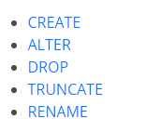
Data Definition (DDL) Commands

Slide 3
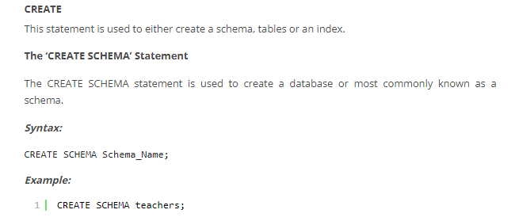
CREATE Database

Slide 4
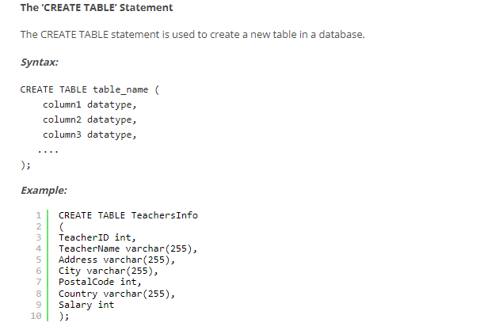
CREATE Table

Slide 5
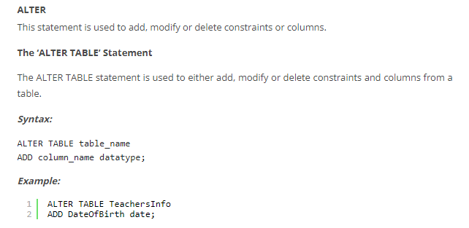
ALTER

Slide 6
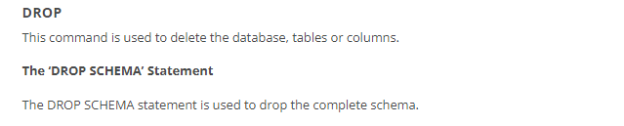
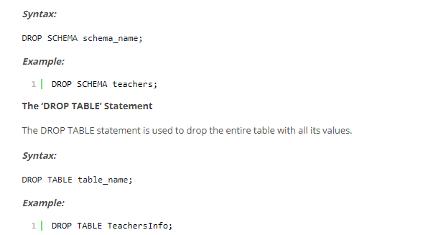
DROP

Slide 7
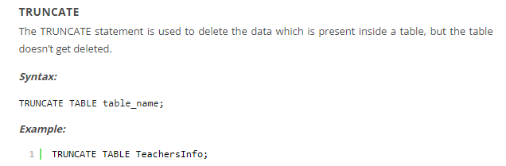
TRUNCATE

Slide 8
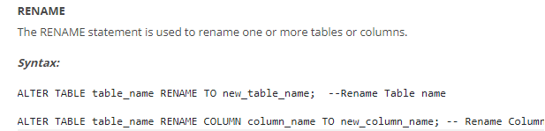

RENAME

Slide 9

Transaction Control (TCL) Commands

Slide 10
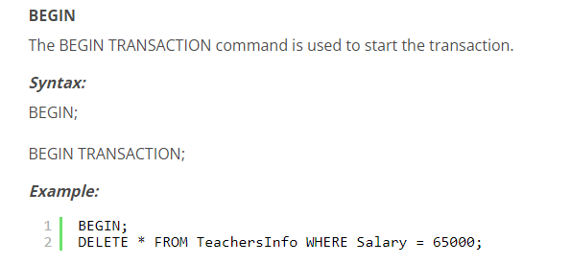
BEGIN

Slide 11
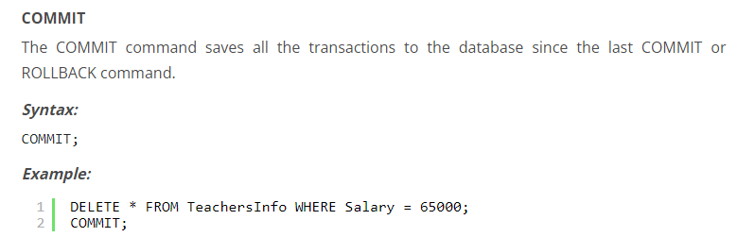
COMMIT

Slide 12
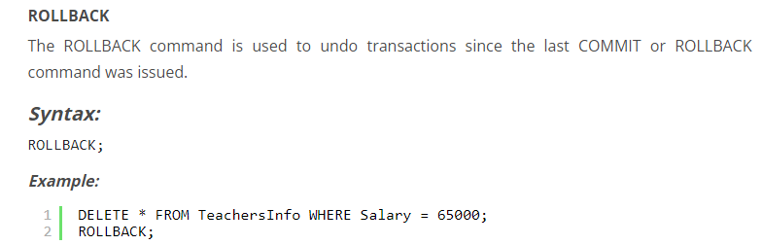
ROLLBACK

Slide 13
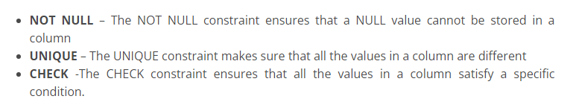
Constraints Used In Database

Slide 14
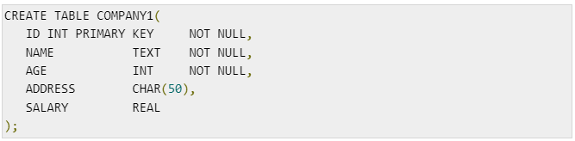
NOT NULL Constraint

Slide 15
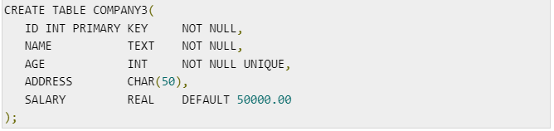
UNIQUE Constraint

Slide 16
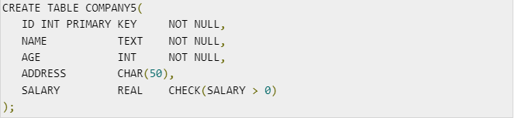
CHECK Constraint

